Slide 1

Error Resolution Deep Dive
Presented By Oluseun Temiye

Slide 2






Introduction
Error Extraction
In its most basic sense, data quality…
We will see how to generate error
Logs from the NDR
Extracting Error Log from NDR
Training Out comes
Introduction
Data Quality Assurance
Check XML
Important Fields
Data Quality Assurance
Ensuring Correctness on NDR
Steps to ensure Quality
Learn how check xml for errors
Important Fields
Line list concurrence
Some important fields
Field to field EMR / NDR check

Slide 3
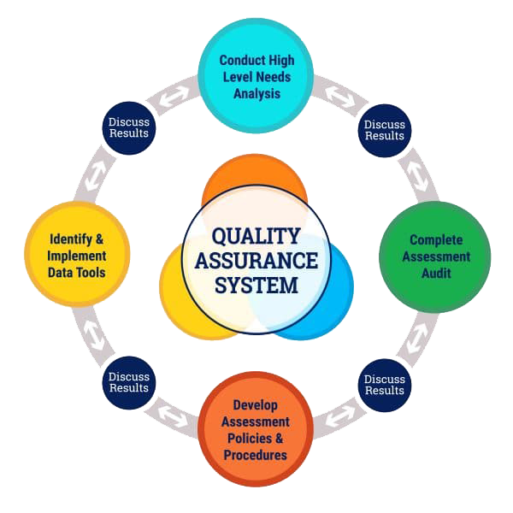
Training Out comes
Important Fields
Data Quality Assurance
Extracting Error Log from NDR
Ensuring Correctness on NDR
Introduction
In its most basic sense, data quality means that the information collected as part of monitoring and evaluation system adequately represents the program’s activities.
Adequately represents means that the information is accurate and reliable.

Slide 4

Important Fields
Ensuring Correctness on NDR
Data Quality Assurance
Extracting Error Log from NDR
Introduction
Training Out comes
Wrong Regimen Line At Start
Blank Regimen Information
Blank Days of Refill
Wrong ART Start Date
No Visit date attached to encounter

Slide 5
PepID
ARTStartDate
LastPickupdate
Days Of ARV Refill
01
02
CurrentARTRegimen
CurrentViralLoad
DateofCurrentViralLoad
CurrentARTStatus
Extracting Error Log from NDR
Important Fields
Data Quality Assurance
Introduction
Ensuring Correctness on NDR
Training Out comes

Slide 6
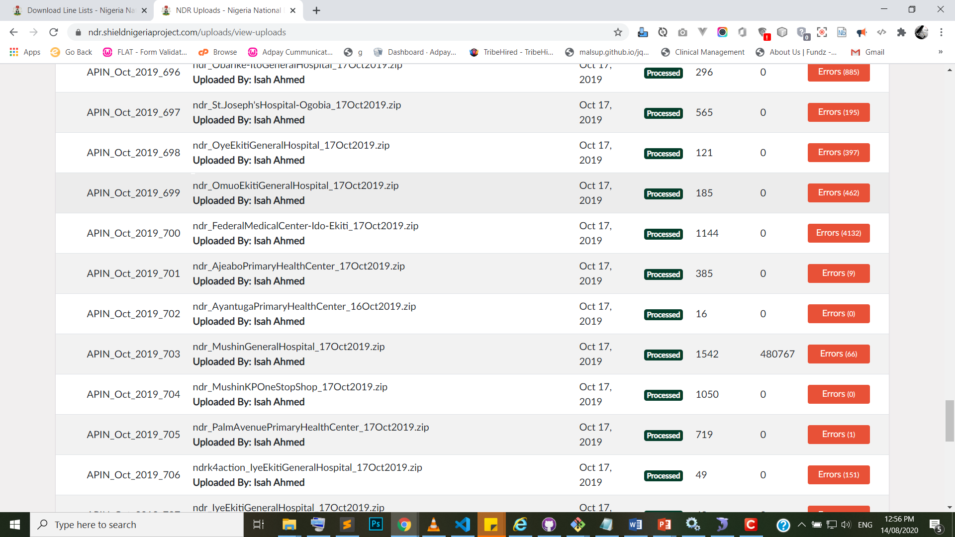
Data Quality Assurance
Ensuring Correctness on NDR
Extracting Error Log from NDR
Important Fields
Training Out comes
Introduction

Slide 7

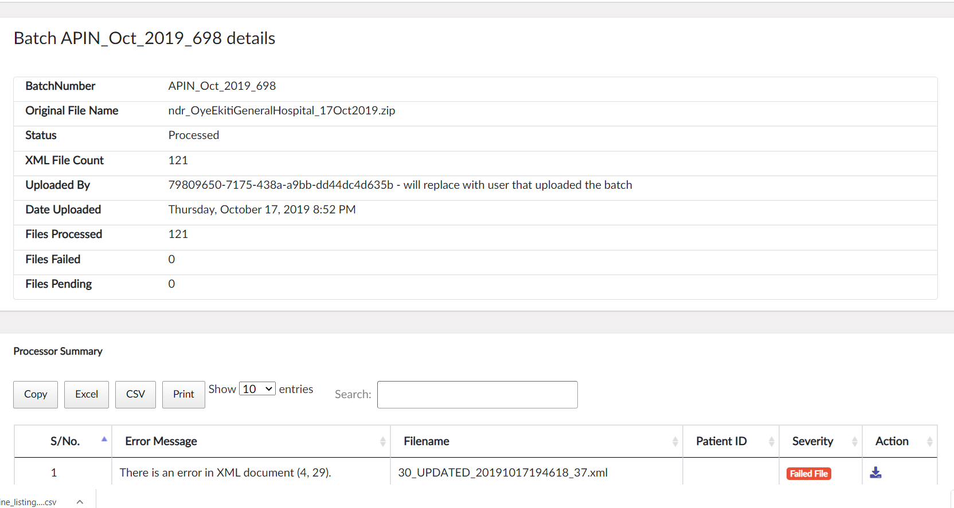
Extracting Error Log from NDR

Slide 8
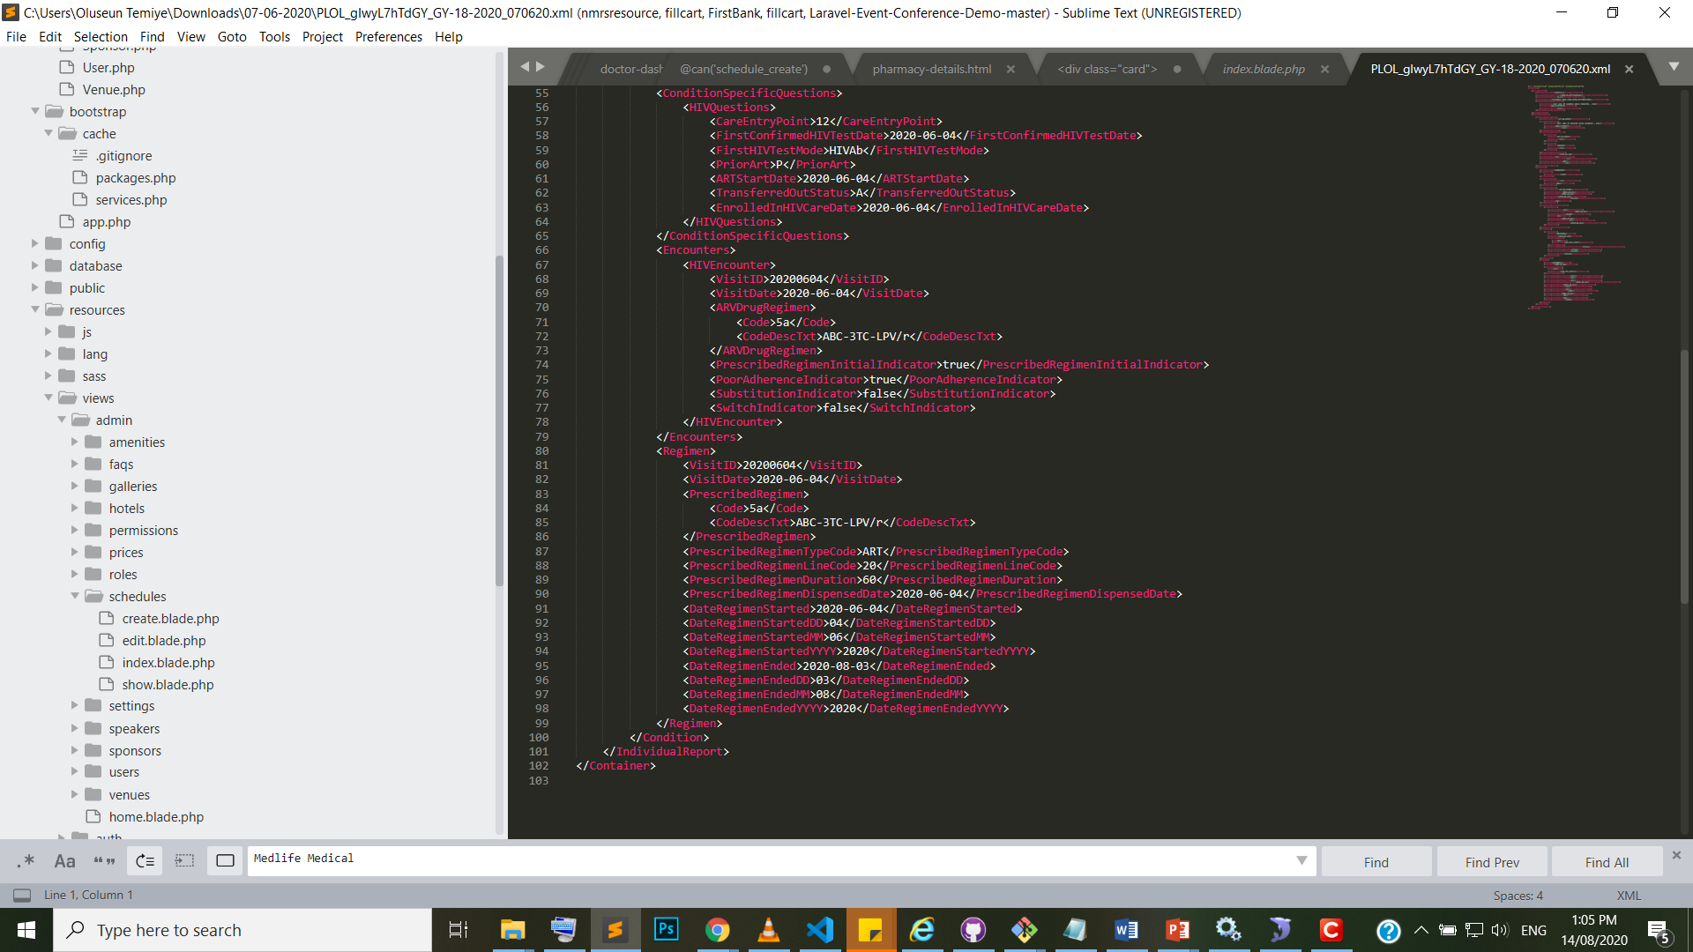
Ensuring Correctness on NDR

Slide 9
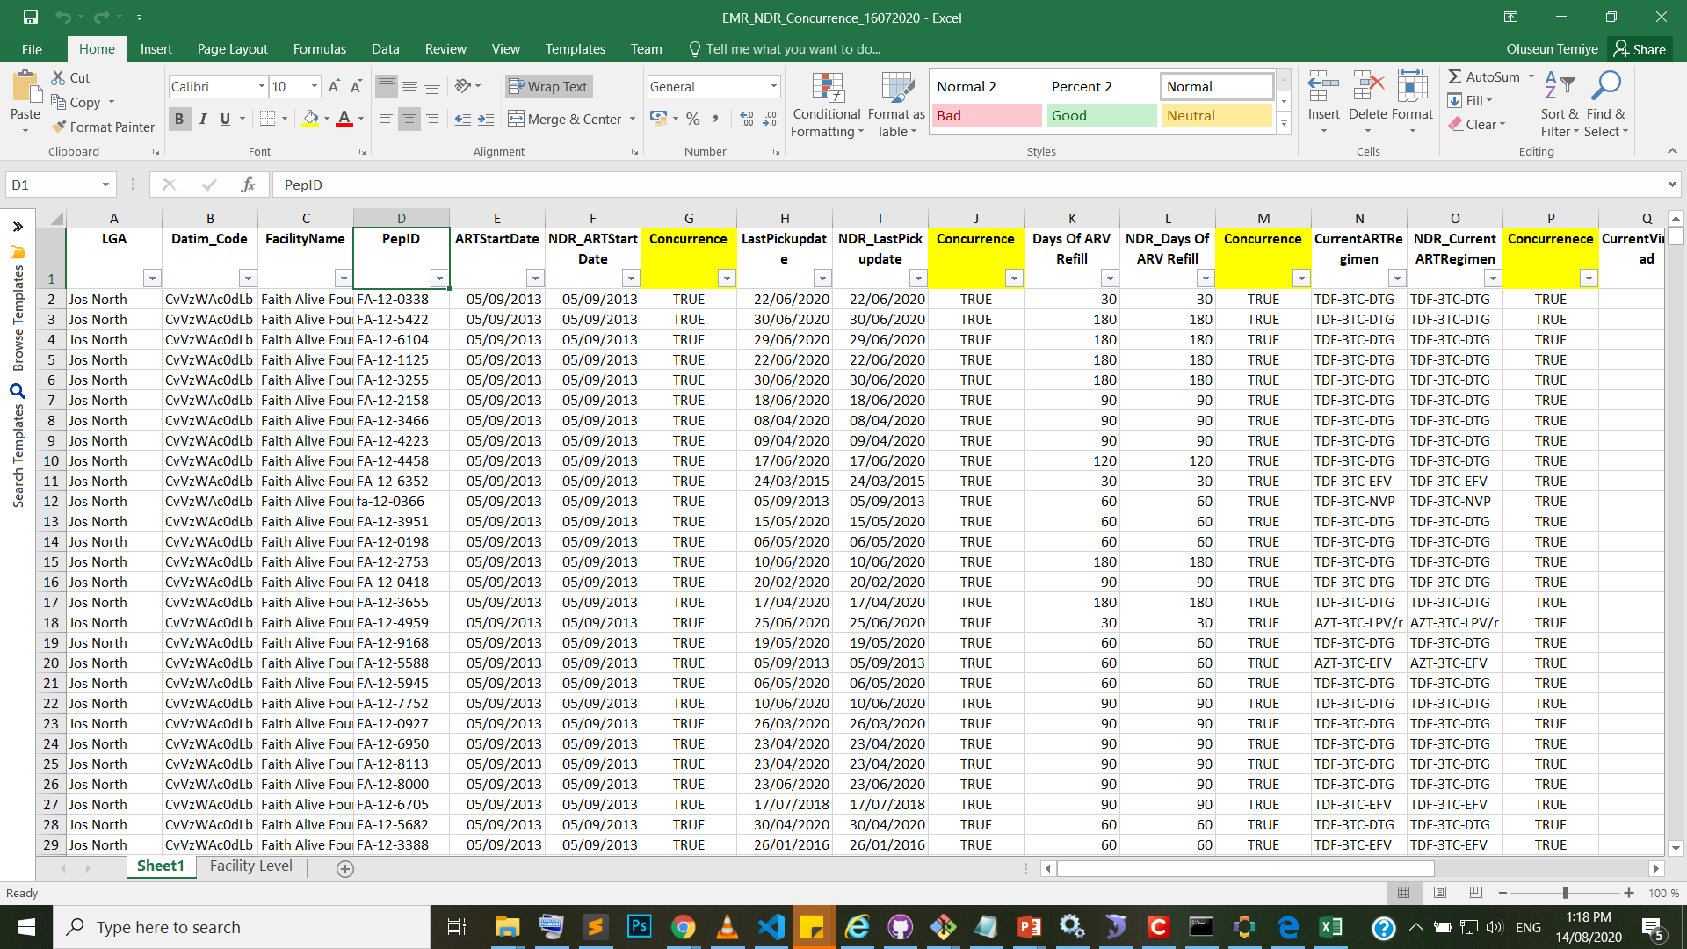
Line List Concurrency
Important Fields
Training Out comes
Introduction
Extracting Error Log from NDR
Data Quality Assurance

Slide 10


